Slide 1
Introduction to e-Filing & e-Registration https://rerc.rajasthan.gov.in
Mar 2021
Presented by : NIC Jaipur

Slide 2
Who can do Registration
Organization
Advocates
Individual
Employee
(of already registered organization)

Slide 3
How do we Registration for e-Filing RERC web portal

Slide 4
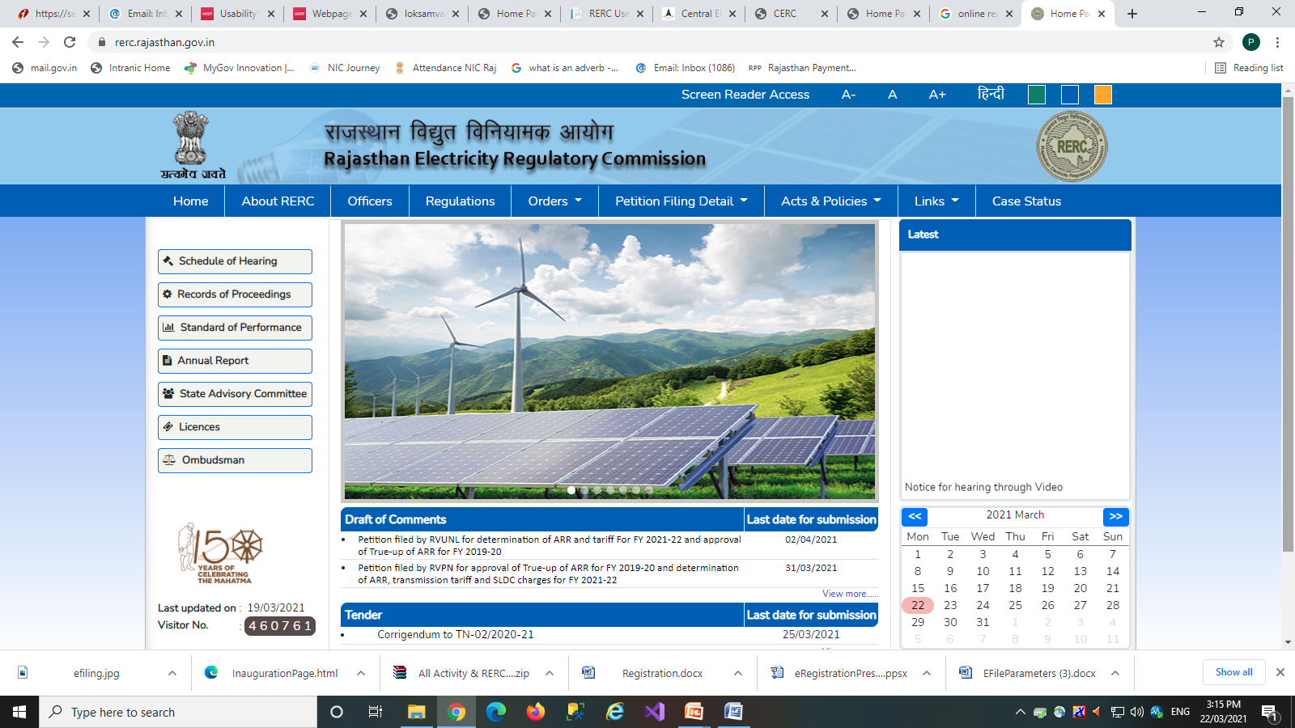
e-Filing

Slide 5
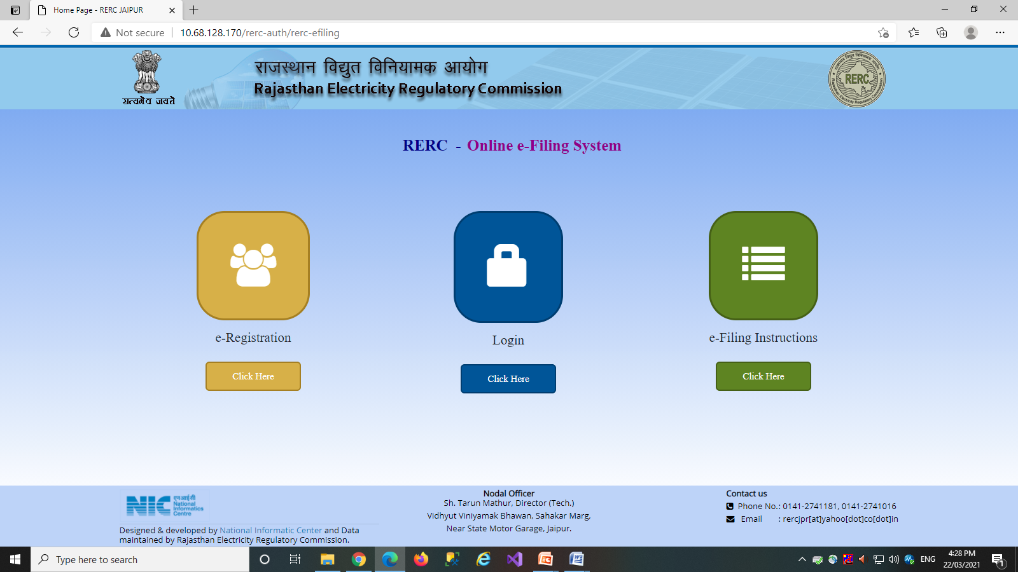

Slide 6
User Registration - Prerequisites
Organization Registration
GSTIN no
Employee ID & details of Administrator
ROC /GSTIN scanned copy to upload
Email/mobile to register for communications
Advocate Registration
PAN number
Bar council number, year & state
Bar council ID scanned copy to upload
Individual
PAN number
Security Code of Organization
Employee ID
Authorization letter of Organization
Employee of Organization
PAN number
ID proof scanned copy (PAN/Driving License/voter ID)
Prerequisites

Slide 7
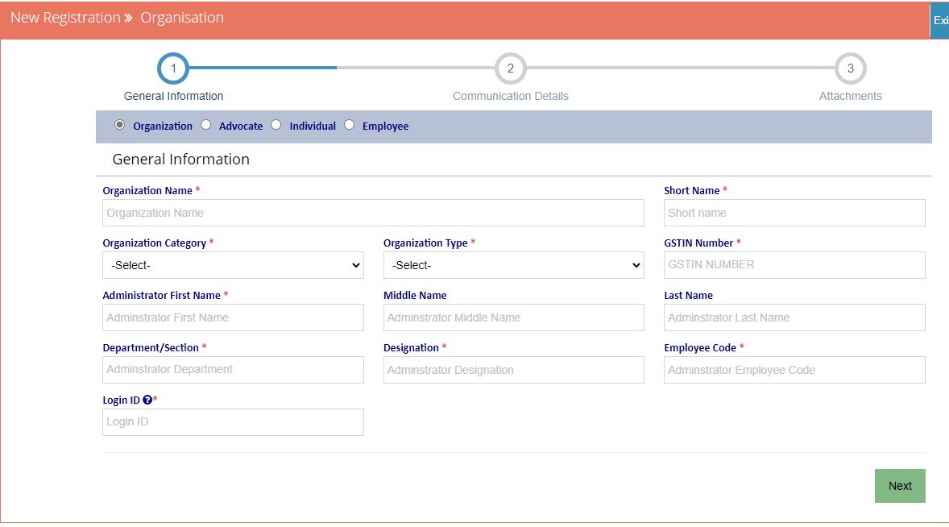
Organization Registration

Slide 8
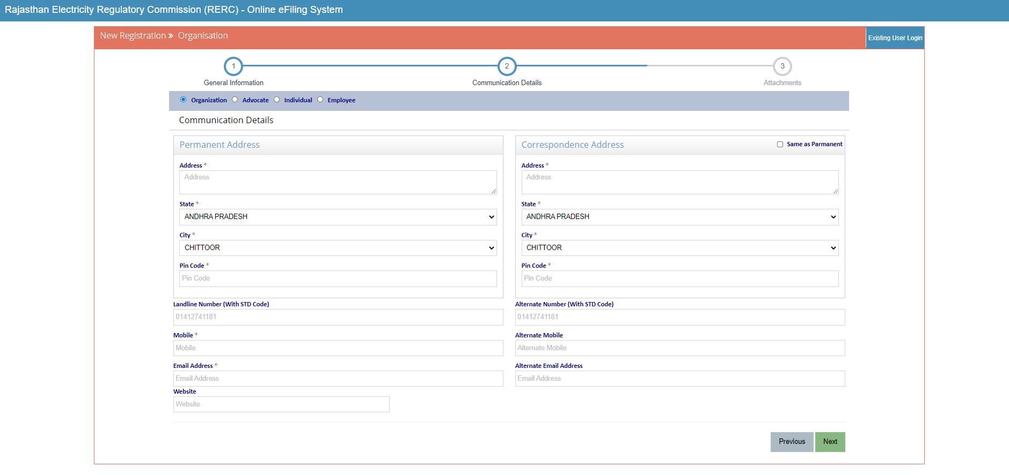
Organization Registration

Slide 9
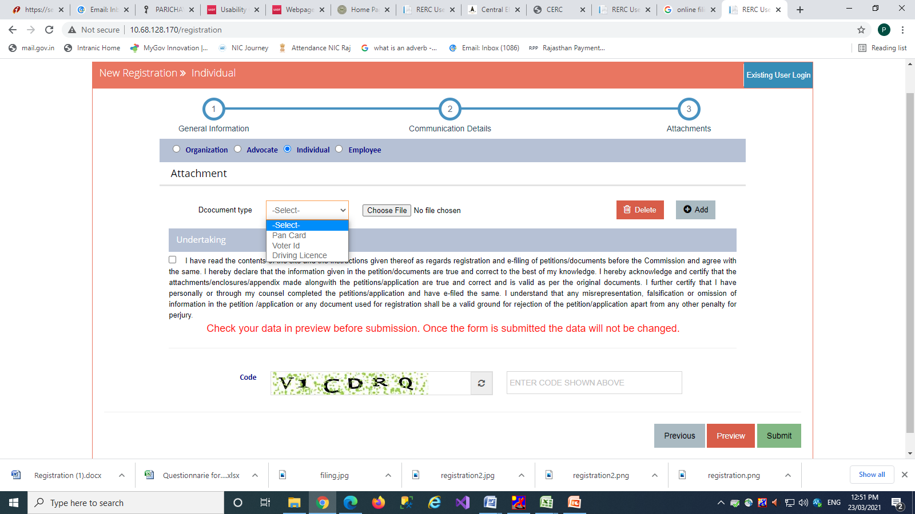
Organization Registration
Check undertaking
Enter the code here

Slide 10
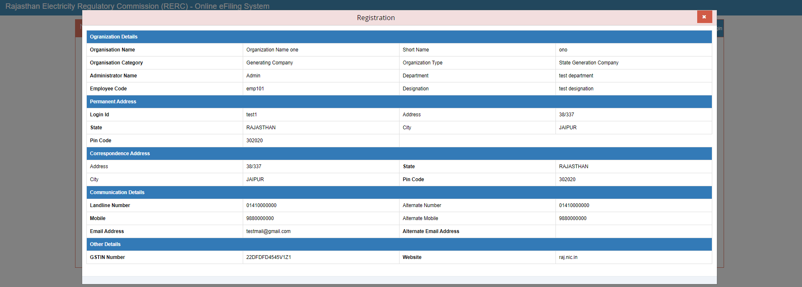
Organization Registration

Slide 11
Organization Registration

Slide 12
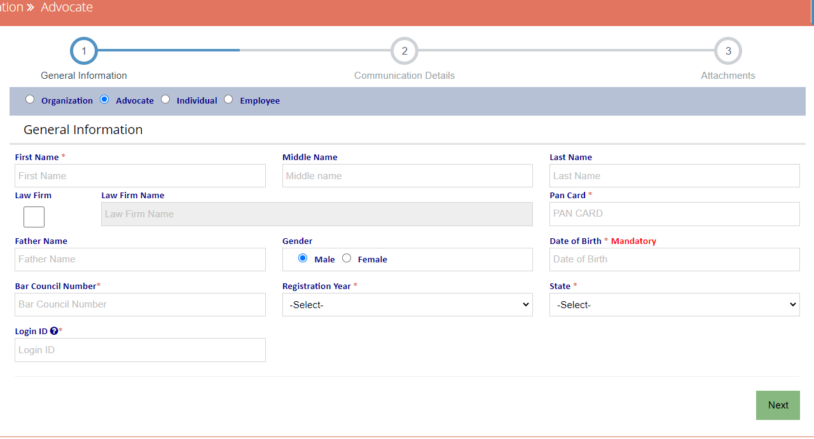
Advocate Registration

Slide 13
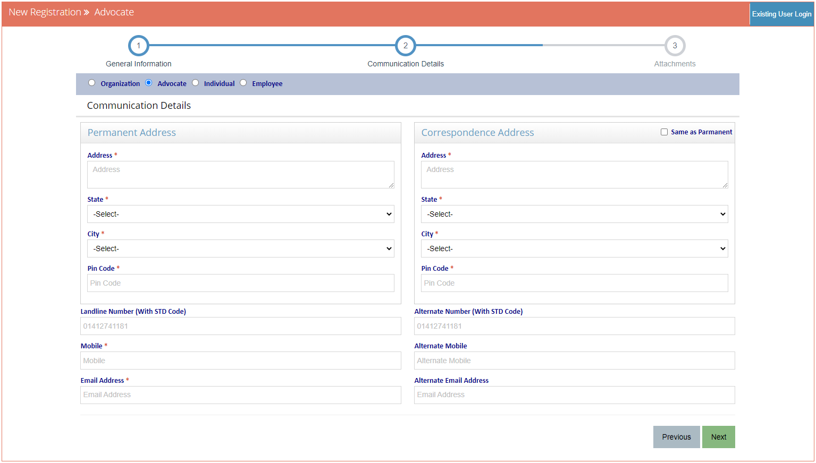
Advocate Registration

Slide 14
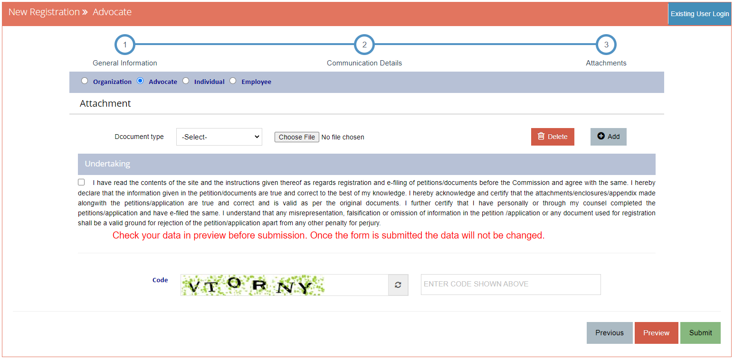
Advocate Registration
Check undertaking
Enter the code here

Slide 15
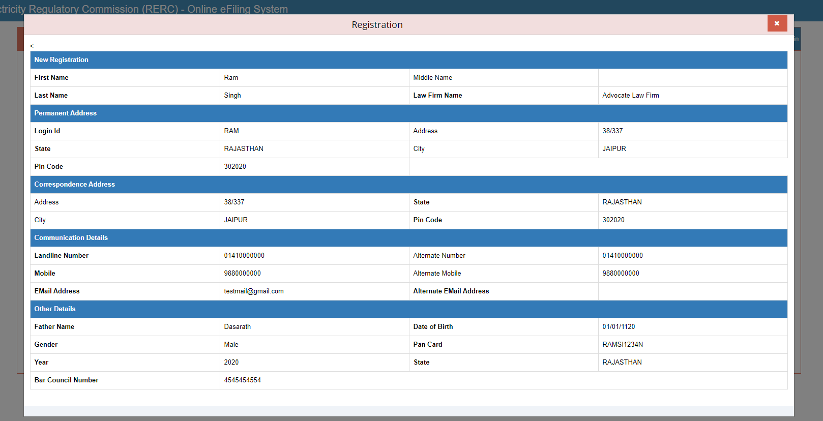
Advocate Registration

Slide 16
Advocate Registration

Slide 17
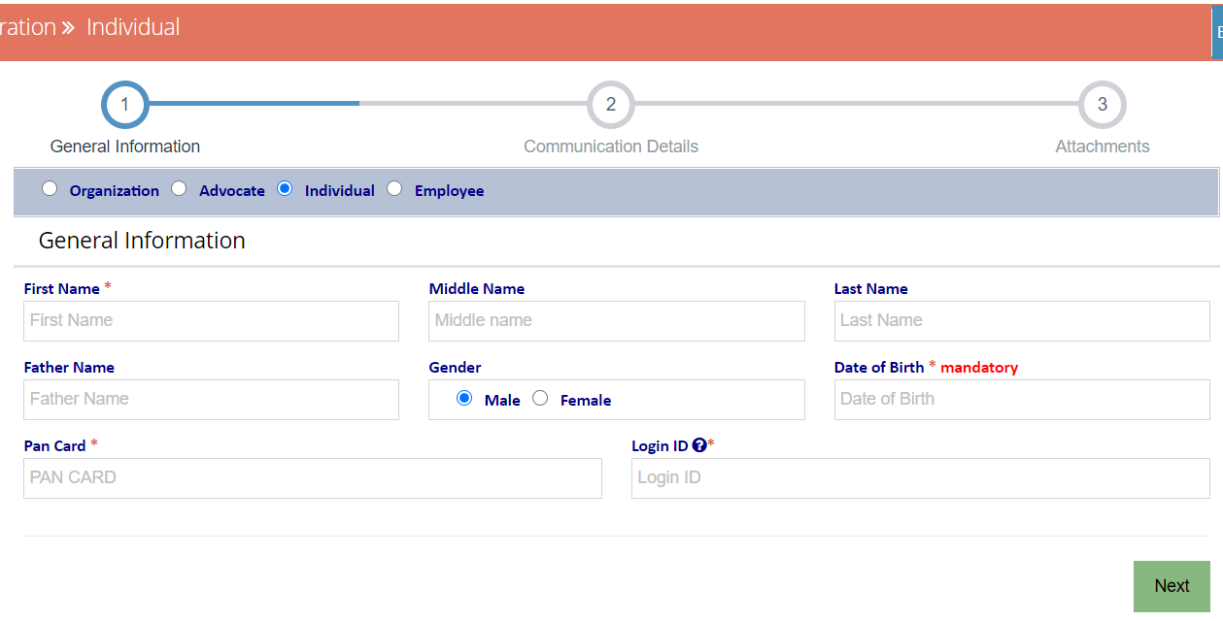
Individual Registration

Slide 18
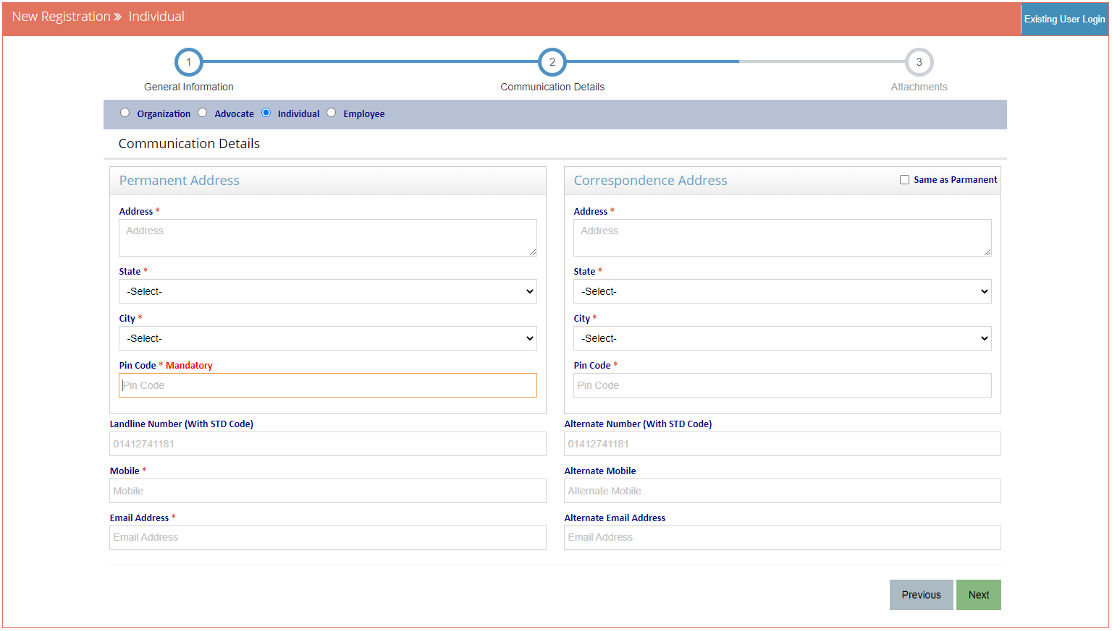
Individual Registration

Slide 19
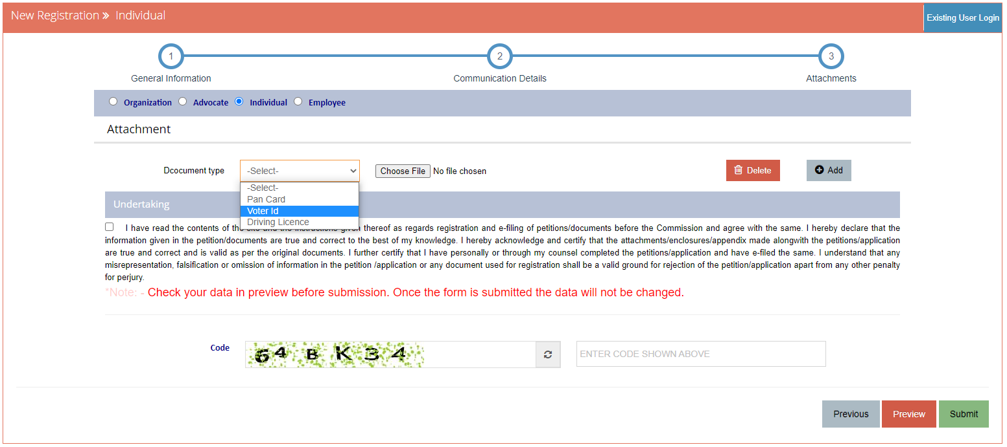
Individual Registration
Check undertaking
Enter the code here

Slide 20
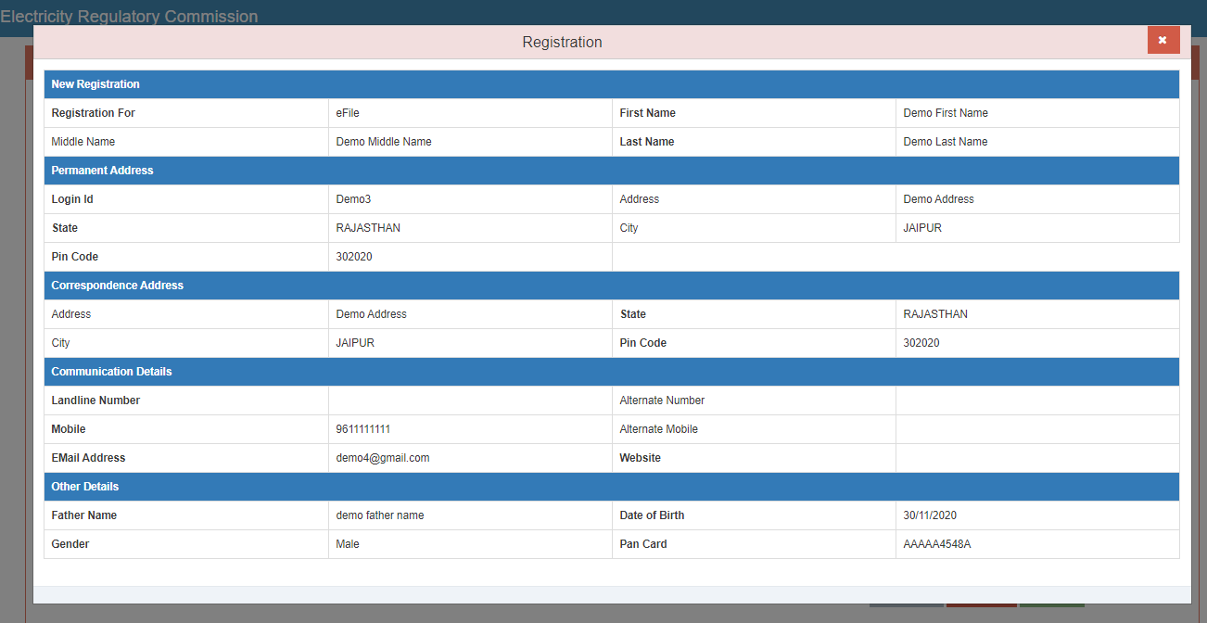
Individual Registration

Slide 21
Individual Registration

Slide 22
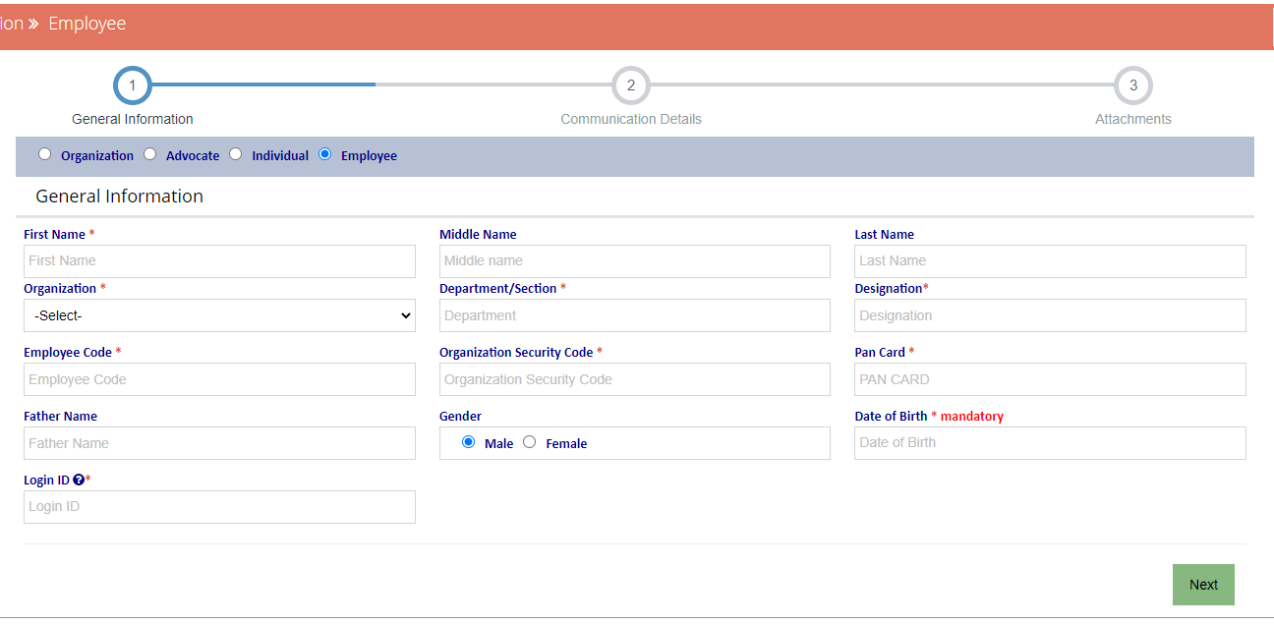
Employee Registration

Slide 23
Employee Registration

Slide 24
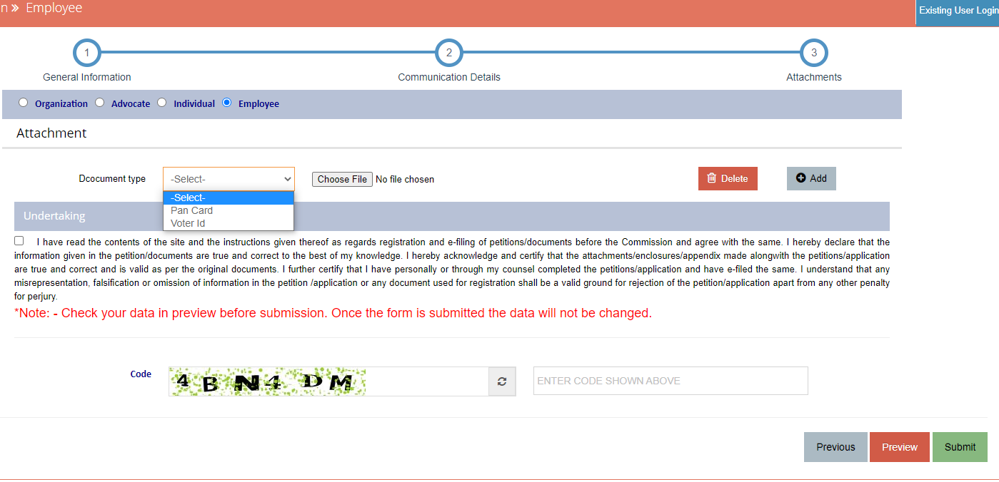
Employee Registration
Check undertaking
Enter the code here

Slide 25
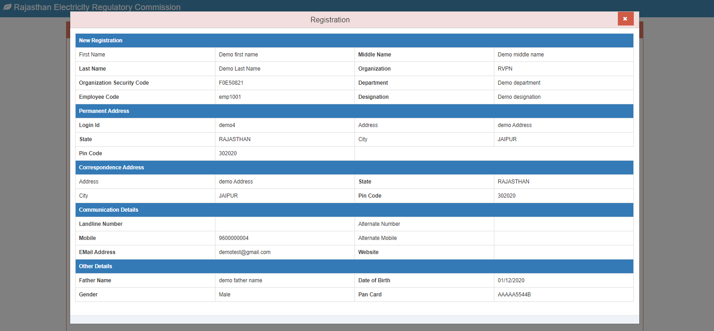
Employee Registration

Slide 26
Employee Registration

Slide 27
Thanks

